Slide 1
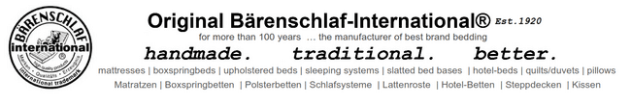


Slide 2
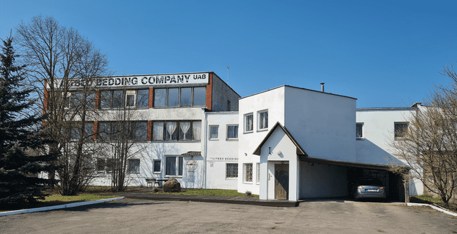
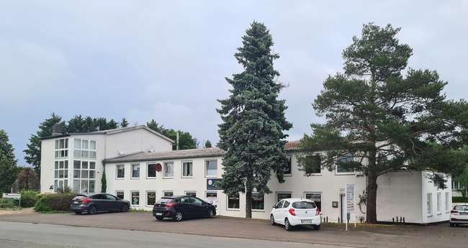
COMPANY PRESENTATION
company :
Litbed bedding company UAB Est.2000
Bärenschlaf-International®
Geliu g. 27 (Auseniskiu km.)
LT-21366 Vievis
Litauen / Lithuania
SHOWROOM & office LITHUANIA
company :
Holger Klute GmbH & Co.KG.
Bärenschlaf-International® Est 1920
Bunsenstr. 28
D-34466 Wolfhagen
Deutschland/Germany
SHOWROOM & office GERMANY

Slide 3


OUR BRAND AND PRODUCT-GROUPS
OUR BRAND is traditional family owned private by family Klute
(today by Mr.Holger Klute) Our brand is a in words and picture protected registered trademark - strictly saved and protected by our patent lawers
Our traditional handmade manufactured best brand bedding products are :
mattresses |boxspringbeds |upholstered beds |slatted bed bases |duvets+pillows

Slide 4
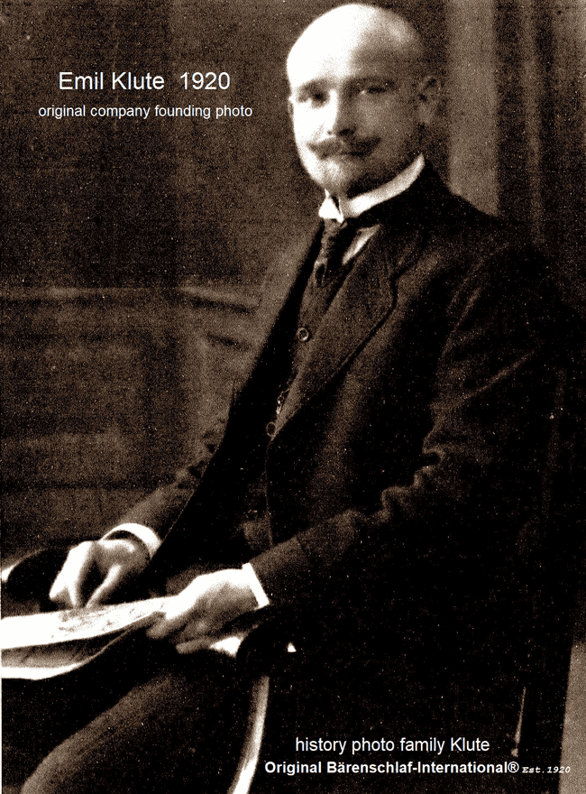
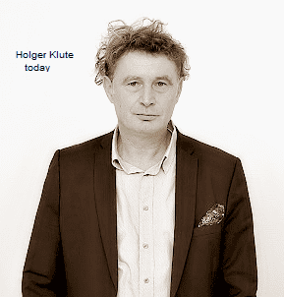
COMPANY HISTORY SHORT CUT INFORMATION
Our family buiz was established in 1920 by the grandfather of Mr. Holger Klute , Mr. Emil Klute in Hagen - Germany

Slide 5
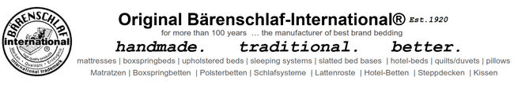

COMPANY HISTORY STORY
Emil Klute founded the first production company 1920 in Hagen -Germany for to produce various wire products, spring units , mattresses and spring unit bed bases . His sons Helmut and Günter Klute moved the factory with the company name EKS (Emil Klute and sons) after the 2nd World War first to the German village Lütersheim and than to German town Wolfhagen , where they installed self constructed machines for to manufacture high end quality bedding products with a maximal optimized durability . The idea of Emil Klute was to combine best sleeping comfort with the highest level of material quality for a maximal longtime usement . In the following years, the production was permanently modernized and in 1984 Holger Klute ( The sun of Günter Klute ) started to work in the company . Already in 1989 Günter and Holger Klute installed and opened up additional production plants in a East-German tow called Crimmitschau . In 1986 , Holger Klute becomes the CEO of the Klute company group in Germany and the private owner of the brand Bärenschlaf-International®. This brand stands for many years of company tradition , handmade high end best quality bedding products produces according the very highest german quality standards. By getting also focused on the belongings of hotels and the hospitality markets the Bärenschlaf-International® branded hotelbeds became famos in the german-speaking countries . By bringing iBärenschlaf-International® products to the retail buiz in Germany , Austria and Switzerland private consumers requesting our handmade quality bedding products until today . The company Litbed Bedding Company UAB in Lithuania (established in 1999 and company registered in 2000 ) started to manufacture Bärenschlaf-International® high quality bedding products Today we are very proud of our company tradition ,our achievements and knowledge . We are always happy to configure, personalize and customize our boxspringbeds and mattresses for our customers in Europe ond Overseas . Because we love to be creative . We love to design , construct configure and individualize every boxspringbed ,upholstered bed for every customer project wish .

Slide 6
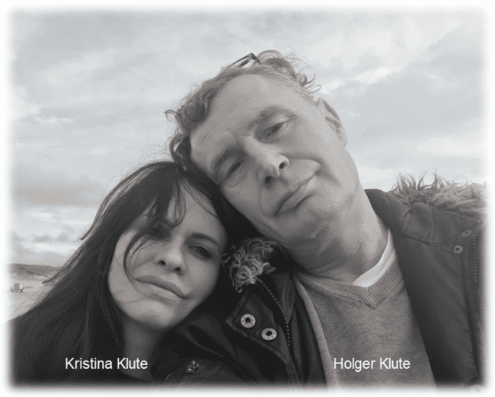

ABOUT US TODAY
Today Kristina and Holger Klute are managing the Bärenschlaf-International® companies from our headoffice in Vievis in LITHUANIA . We love what we are doing and welcome you to visit our SHOWROOMS in WOLFHAGEN – GERMANY and VIEVIS – LITHUANIA . Where you can see , feel and touch all of our materials and the handmade high quality of our craftsman at work. We are proud of our high motivated and skilled team of craftmen . Wich is creating the unique high end quality of our Bärenschlaf-International® bedding products in our production always tradidinal according the highest german quality standards and international bedding material certification rules . In partnership with professional interior – architects , interior – designers , architecs , hotel – investment – companies and hotel – development companies we create , configurate and calculate every day new individual hotelbeds , mattresses , boxspringbeds and motorized adjustable beds . We loved being on the floor with our production team , trouble-shooting our production and machines and making improvements. We love our traditional old craftsmanship and the idea that our beds and mattresses are used to last a person’s whole life. We chose to bring back the lost art of hand tufting and handmade craft because it creates a unique best sleeping comfort and most durable bedding product wich our quality orientated target clients prefere . Our know-how is based in the companies-history and the image of our brand. Family owned we are producing our bedding products in the 3rd generation since anno 1920. We like to create innovative and individual sleeping comfort solutions in the best long-life quality .Suitable and
wanted for anyone use them in their individual home , hotel ,
holydaypark , caravan , boat , yacht or loft apartment
or villa . This is based on tradition , trust and
partnership . Always : handmade. traditional. better .

Slide 7

INDIVIDUAL CREATED AND CRAFTED ADVANTAGES
our unique handmade special products , creative services and skills
… you design it !
Original Bärenschlaf-International® Est.1920
… we make it !
Our products and services provide sleeping comfort solutions according individual wishes and needs . They have been always specially developed to meet the requirements of any private persons wish , hotels , hospitals , home care activities ,dormitory project , tiny house , luxury villa , loft apartment, yacht, boat or even caravan . Sleeping comfort, hygiene and handling are harmonized with the external visable product design wich can be adapted to each individual clients requirements and wishes . Our individual created product solutions are based on the knowledge of exactly what is important for the usement of a bedding products individual usement All components of our final sleeping product has have to fit and work together in a most comfortable way . That means that the topper and mattress has got always be adapted to it`s bed-base for to give the best sleeping comfort to the user . The healthy sleeping comfort of the bed support and base should be further improved individually by combining pillows and blankets .
After the necessary individual, detailed discussion regarding the product solution personalized for our customers, we develop the most suitable sleep system.
We always offer it individually in advance and are able to adapt it to the customer's wishes right up to the start of production.
With our experience and craftmen`s knowledge we mostly find the very best product solution for our clients wishes in combination with our client`s financial possibilities and budget plannings,

Slide 8
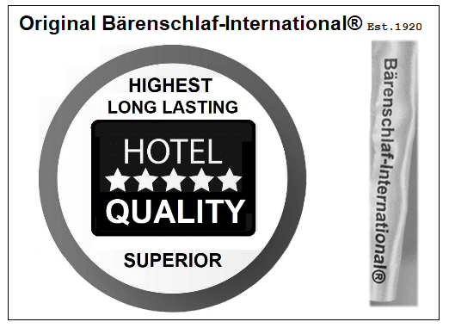
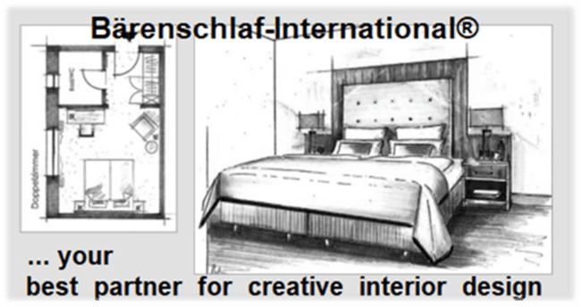
hospitality partner - hotel bedding - success since 1920
Already since the start in 1920 until today -in 3rd generation family-owned - ,we produce and deliver our mattresses , boxspringbeds , upholstered beds and slatted bed bases to the hospitality markets . We are most focused ont the also family owned 4-5 star hotels wich we mostly supply via our hotel interior planning partners . Traditional we are since 1920 active in producing innovative hotel - bedding products .
Some of our historical hotel / hospitality references mentioned here for ex. :
While the hotel-boxspringbed became slowly known as a `Pulmann` - bed
Emil Klute was already producing and delivering this sort of bed construction to hotels in Germany
In the 1980 - ties we produced and supplied via the Accor -partner company Hoteg in Munich all boxpingbed sets for the new building expansion 1+ 2 of the Accor –Group in Germany and Austria . For all Accor branded hotels . Wich are : Mercure Hotels , Novotel Hotels , Ibis Hotels , Sofitel – Hotels ( and some others )
In the years 2019 until beginning of 2021 we produced and delivered all boxspringbeds and mattresses for the biggest holyday – park MARISSA in Germany .
Our orders for hospitality project are mostly provided by our sales –partner – wich are basicly : retailor , wholesellers , hotel –furnishing companies , interior – architects , architects , hotel mail-order companies and hotel procurement organisations . Traditional we keep these company addresses as our secret . For further hotel reference requests we are forced not to publish the hotel-names in due to protect the interrests of our partners and clients .

Slide 9
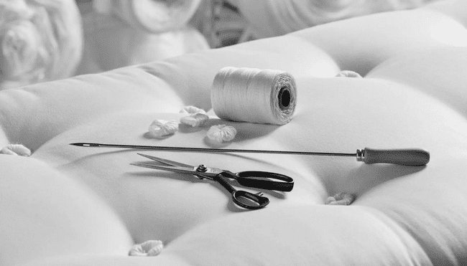

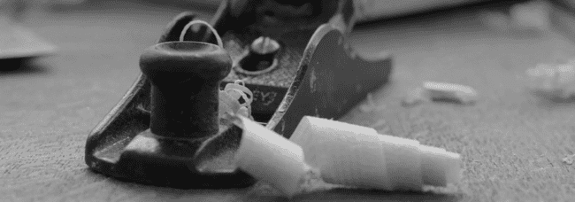
technical production advantage and expertise sought
We produce our handmade mattresses , upholstered beds , boxspringbeds and slatted bed base always according the newest reports of:
- The newest knowledge of sleeping science and hygienic reports ( medical)
- The newest material development reports
- The newest material certification reports
We produce motorized adjustable , manuel adjustable and non-adjustable bed bases and upholstered bed sets .
our professional handmade upholstery department
meets
our professional handmade woodworking department

Slide 10
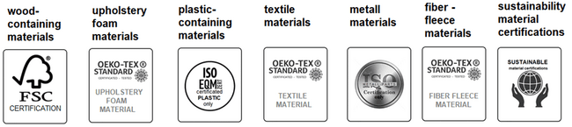

SUSTAINABILITY AND CERTIFICATIONS
highest quality bedding products are our passion–sustainability is our mission
The best mattress and bed base starts with the best materials. The quality of our client`s sleep matters to us. That's why every original Bärenschlaf-International® mattress and bed base is made by hand from 100% certified materials. No no junk - ever. only the best materials are selected (to manufacture them). Since we are an environmentally conscious organization, our products are made from certificated materials to get the well-known excellent quality of the finished Bärenschlaf-International® bedding product. We are passionate about our core values of creating a more natural environment and lessening exposure to unnecessary harmful chemicals while protecting our planet .Just best certified purest materials, assembled with love to make products we're proud to sleep on. Our used materials are permanent controlled and highly durable – so they do not have to been thrown into garbage for years . Our materials are environmentally-friendly and of course non-toxic. They are sustainable and recyclable . The steel wire wich is used for our spring units is based on most durable , solid and sustainable raw steel . Our PES-fibre materials are made from 100% recycled pet bottles . All our foam materials and all of our textiles are Öko-Tex-Standard-100 certificated . Today our skillful team serves our customers worldwide . We believe good is never good, because better is always an expectation we place on ourselves. With this in mind, our team receive on-going training. New ideas and reports about sustainability and quality are constantly added to our knowledge . We permanently improve and test our quality, productivity while processing our work . We are a customer oriented company and as a result we do not just manufacture, but we provide value added services as well. One of the many services we provide is product sourcing and development. This service has enabled many of our customers to source products economically and efficiently. Summarizing, we like to say: the joy in innovation, striving for perfection and quality, fair partnerships, market proximity and thinking in systems and terms are the cornerstones of our corporate policy.

Slide 11

BRAND AUTHORIZED PARTNERSHIP INVITATION ... Let`s make better beds !
We invite you to become an authorized Original Bärenschlaf-International® retail partner. Feel welcome to join our activities and movement ! Ideally, you have an established retail business and share our honest company's core beliefs and views . We believe in handmade quality , traditional old craftsmanship and the idea that our beds and mattresses are used to last a person’s whole life. We want to bring back the lost art of hand tufting and handmade bedding upholstery craft to the consumers , because it creates a unique best sleeping comfort with a most durable bedding product for creating a more natural environment. We aim to provide a seamless purchase process for our high valued Original Bärenschlaf-International® mattresses and beds consumers. What results an excellent opportunity for all parties involved. We would love to hear from you ! If you are interested just contact us by communicate how you would like to get our authorized Bärenschlaf-International® -brand sales partnership started. Maybe some interactions maybe require signing a simple NDA (Non-Disclosure Agreement) or a LOI ( Letter of Intent ) .

Slide 12
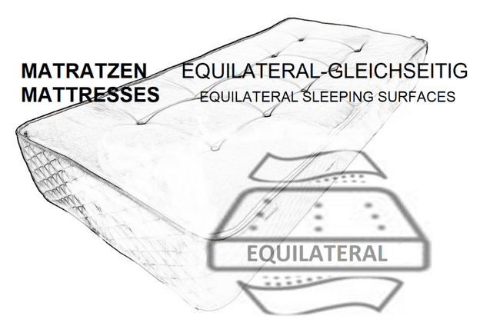
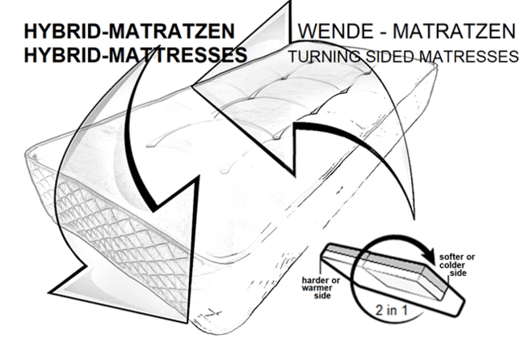
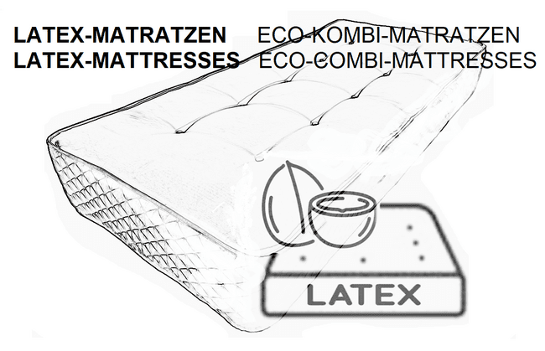
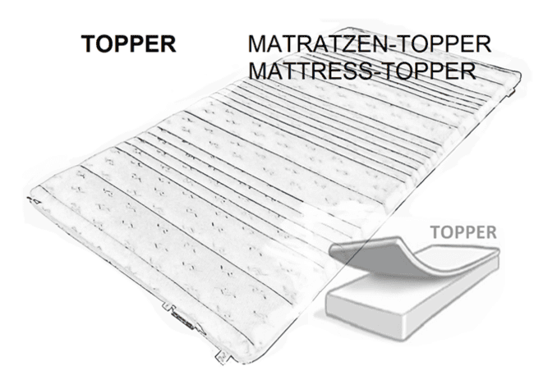
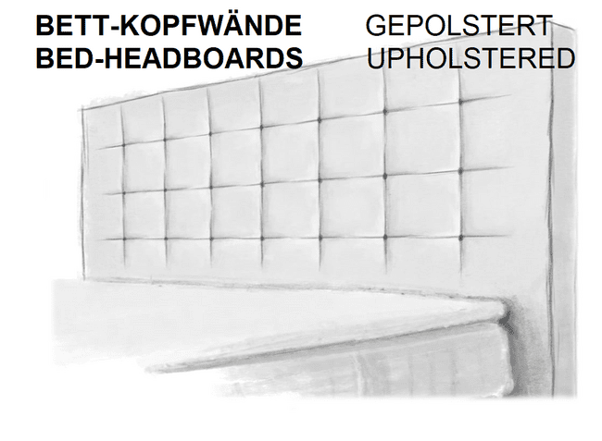
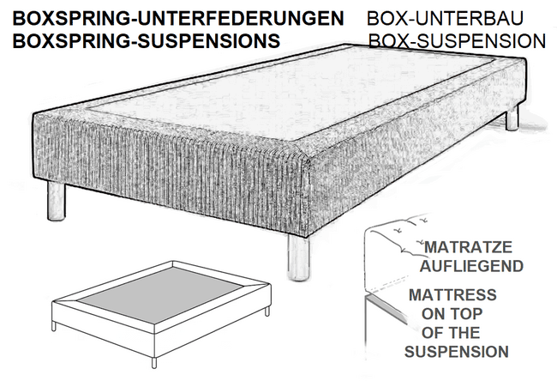
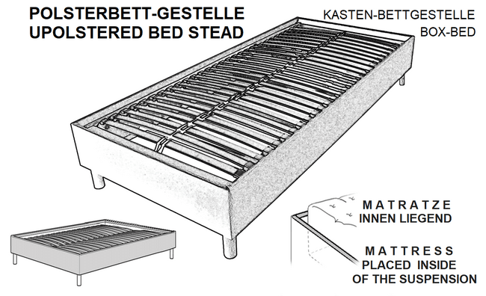
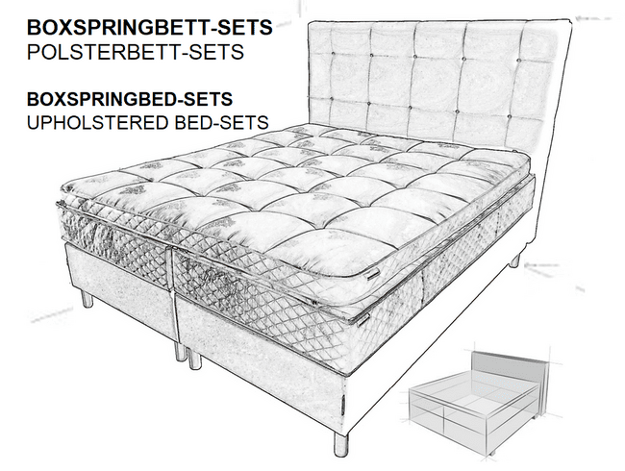
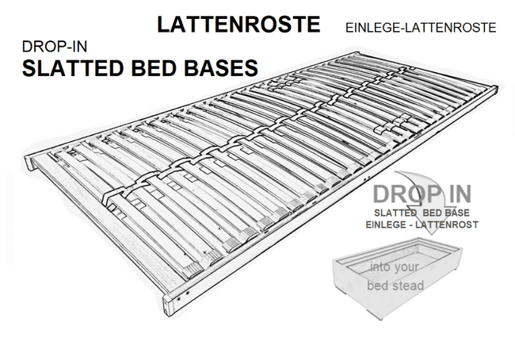
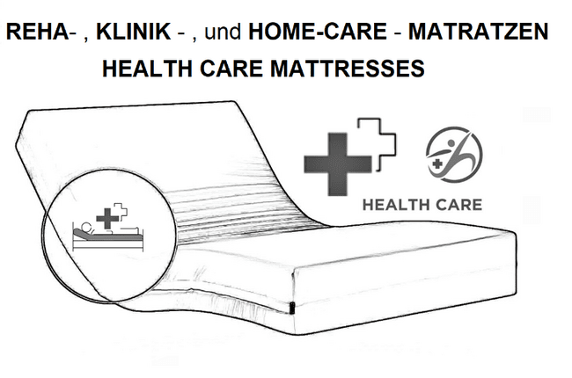
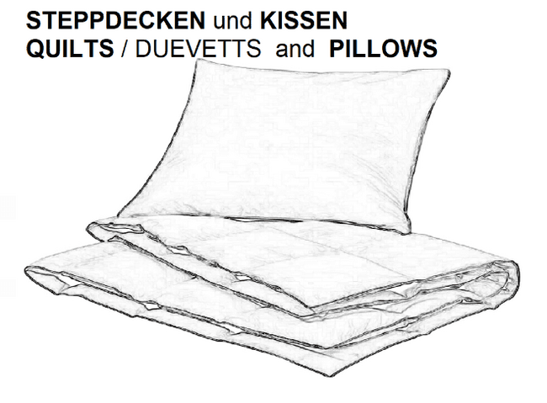
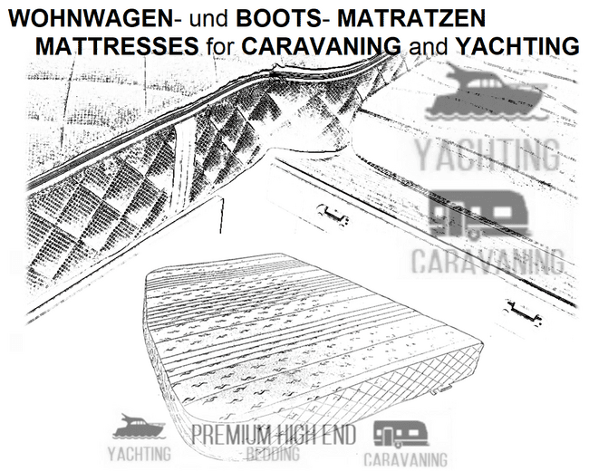
Original Bärenschlaf-International® PRODUCTGROUPS and AREAS OF USE

Slide 13
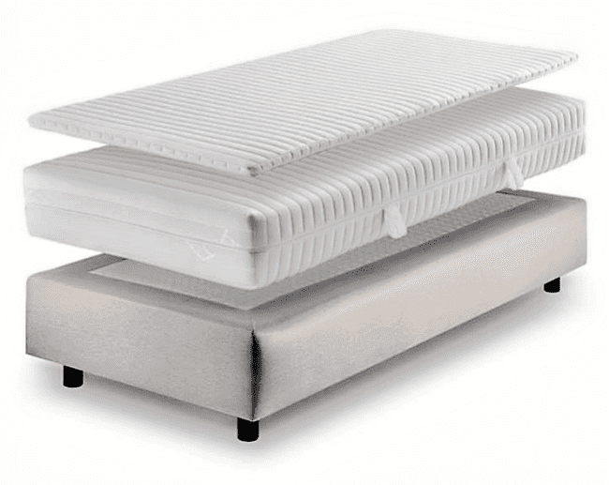
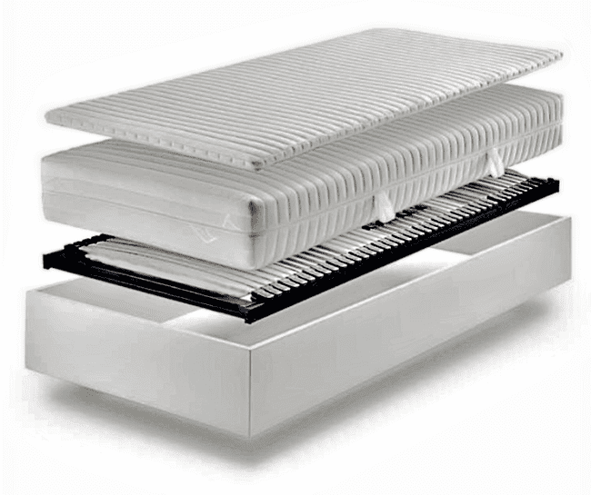
Bärenschlaf-International® handmade luxourious
BOXSPRINGBETT–SETS und POLSTEBETT–SETS
boxspringbed sets and upholstered bed stead sets

Slide 14
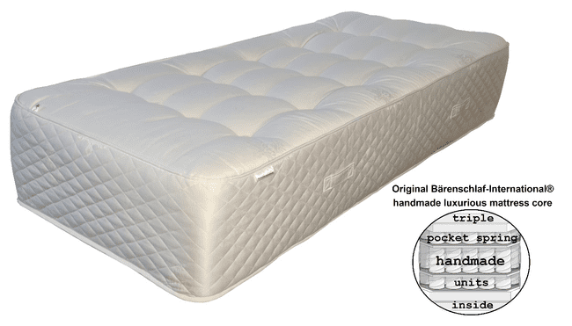
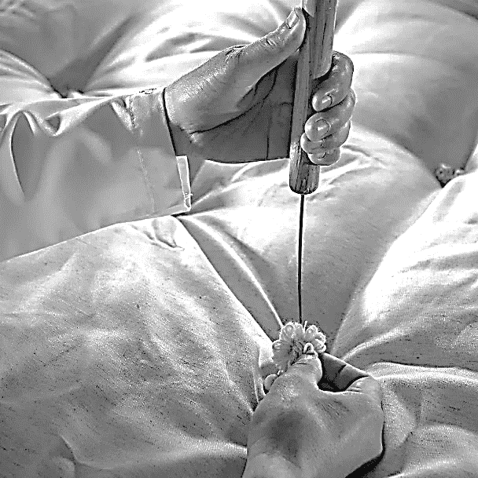
Bärenschlaf-International® luxurious hand-tufted
triple spring mattresses with original belgian damast

Slide 15
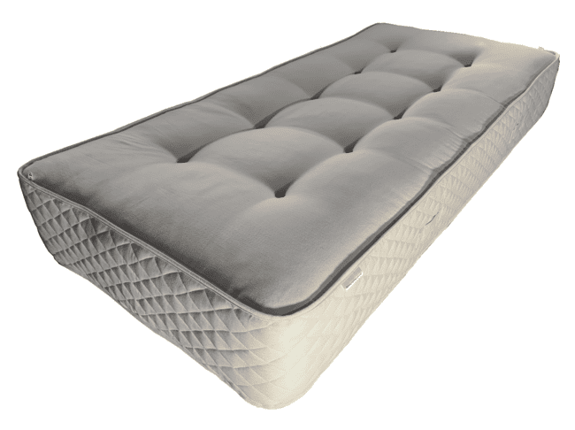

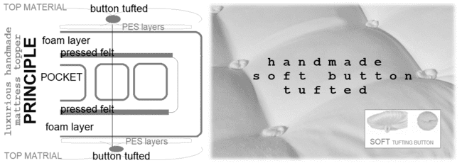
Bärenschlaf-International® luxurious hand-tufted
mattresses with natural
cotton top textile

Slide 16
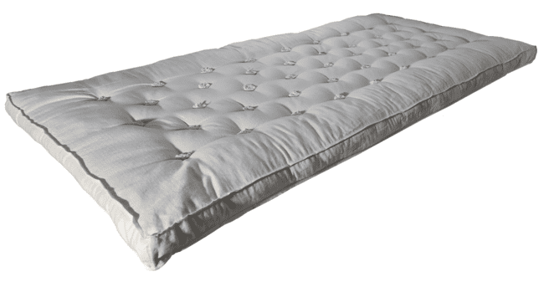
Bärenschlaf-International® luxurious handmade
topper

Slide 17
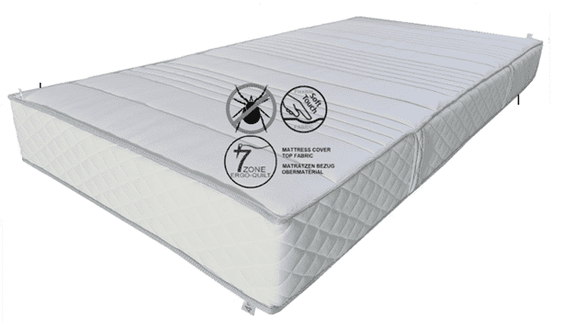

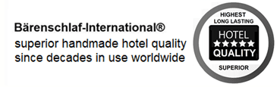
Bärenschlaf-International® most durable handmade
hotel-quality mattresses

Slide 18
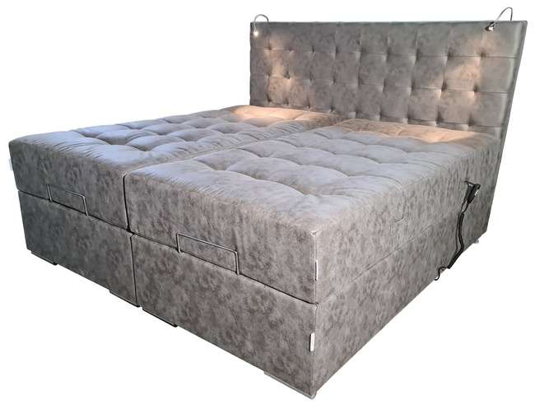

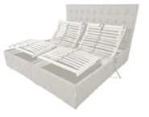
Bärenschlaf-International®… luxurious handmade motorized
upholstered bed stead set

Slide 19
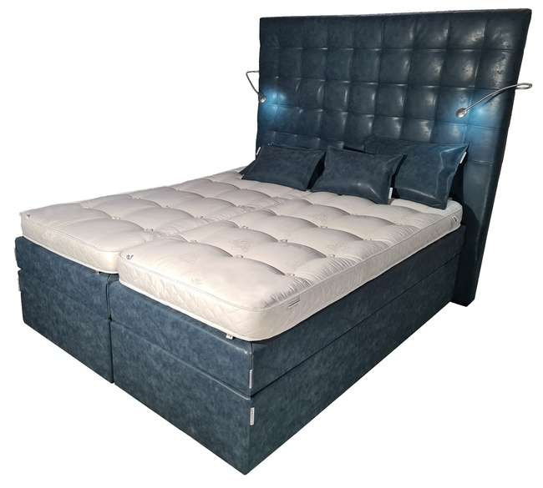
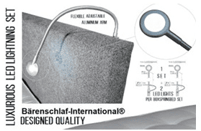

Bärenschlaf-International® luxurious handmade
boxspringbed set

Slide 20
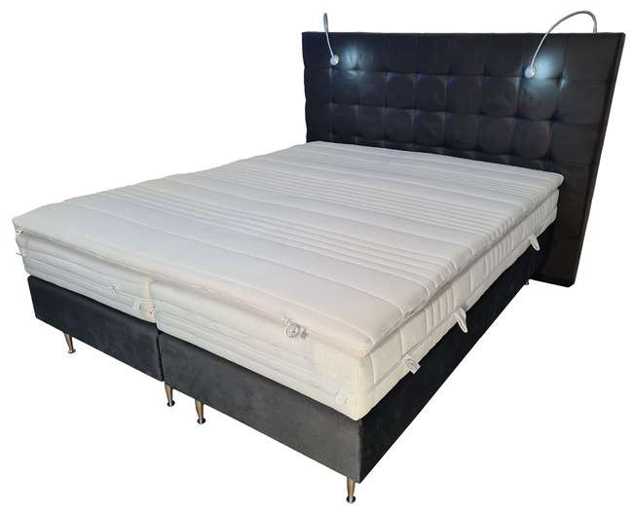
Bärenschlaf-International® luxurious handmade hotel
boxspringbed set

Slide 21
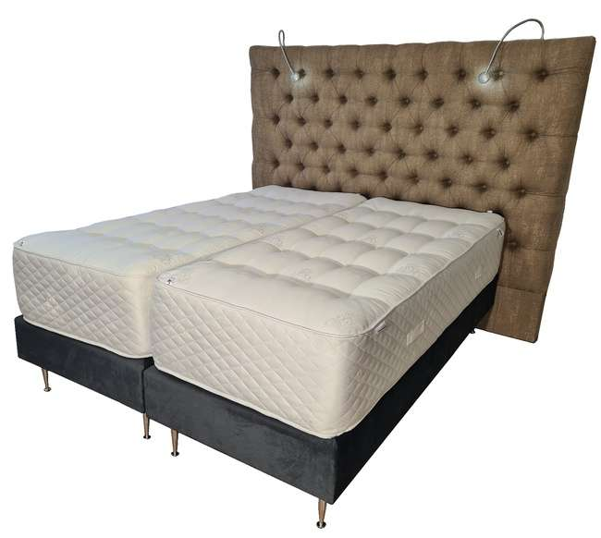
Bärenschlaf-International® luxurious handmade royal classic
boxspringbed set

Slide 22
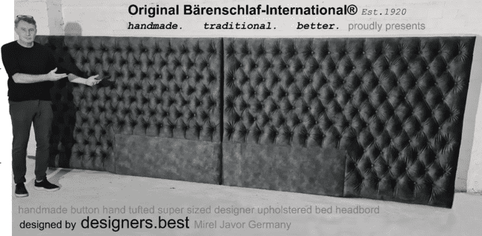
Bärenschlaf-International® luxurious handmade headboards

Slide 23
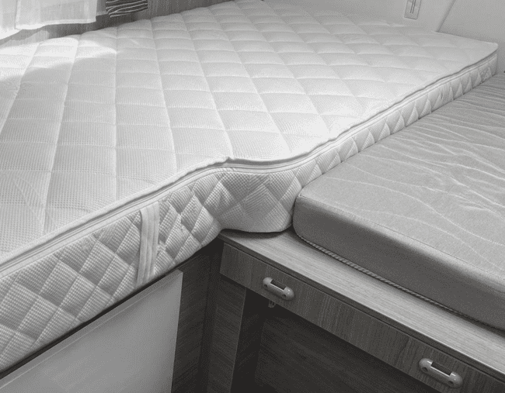

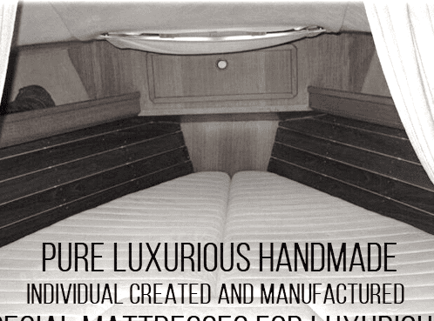
Bärenschlaf-International® handmade individual created mattresses for luxurious yachting and caravan projects

Slide 24
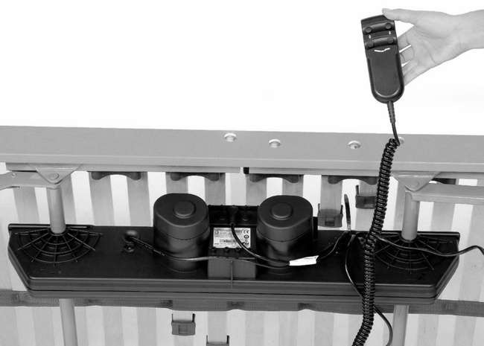
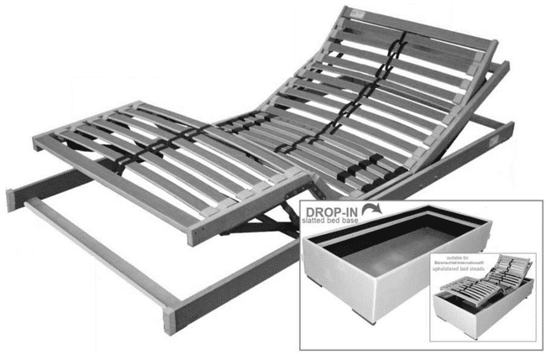
Bärenschlaf-International® luxurious handmade
motorized drop-in slatted bed bases

Slide 25
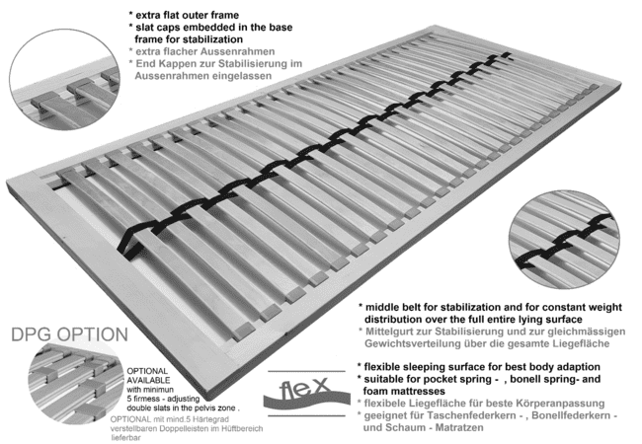
Bärenschlaf-International® handmade
drop-in slatted bed bases

Slide 26
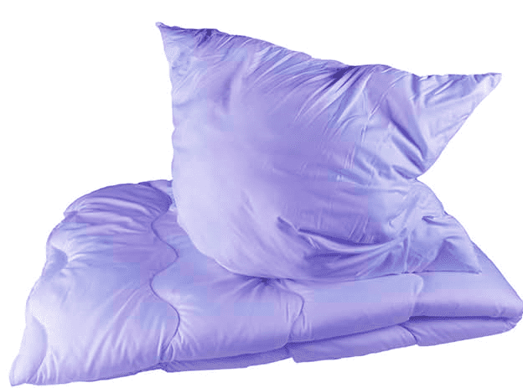
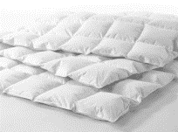
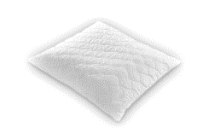
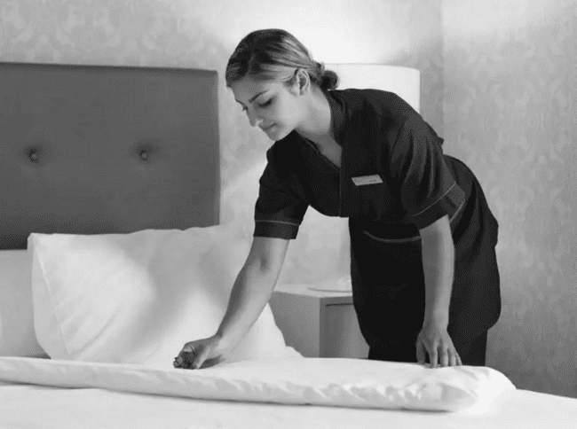
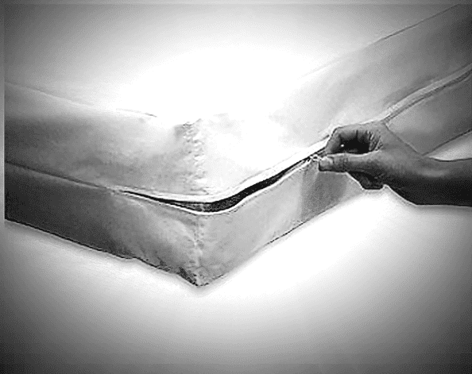

Bärenschlaf-International® luxurious quilts/duvets | pillows
and encasing mattress protection products

Slide 27


Bärenschlaf-International® showrooms
We invite you to visit us in our showrooms and want to welcome you there anytime ....
contact Holger Klute
English or German
email holger@litbed.lt
phone 00370.6833.7790
contact showroom Wolfhagen
Germany Claudia Pflimpfl
German language
email claudia.pflimpfl@baerenschlaf.de
phone 0049.177.75 68 038
Bärenschlaf-International® showroom D-34466 Wolfhagen
GERMANY DEUTSCHLAND
Contact showroom Vievis
Lithuania : Kristina Klute
Lithuanian or English language
Email kristina@litbed.lt
phone 00370.6930.0519
Bärenschlaf-International® showroom LT-21366 Vievis
LITHUANIA LITAUEN
Deutschland / GERMANY : Holger Klute GmbH & Co.KG | Bunsenstrasse 28 | D-34466 Wolfhagen
Litauen / LITHUANIA : Litbed bedding company UAB | Geliu g. 27 (Auseniskiu km.) | LT-21366 Vievis

Slide 28










handmade impression photos while crafting

